Slide 1
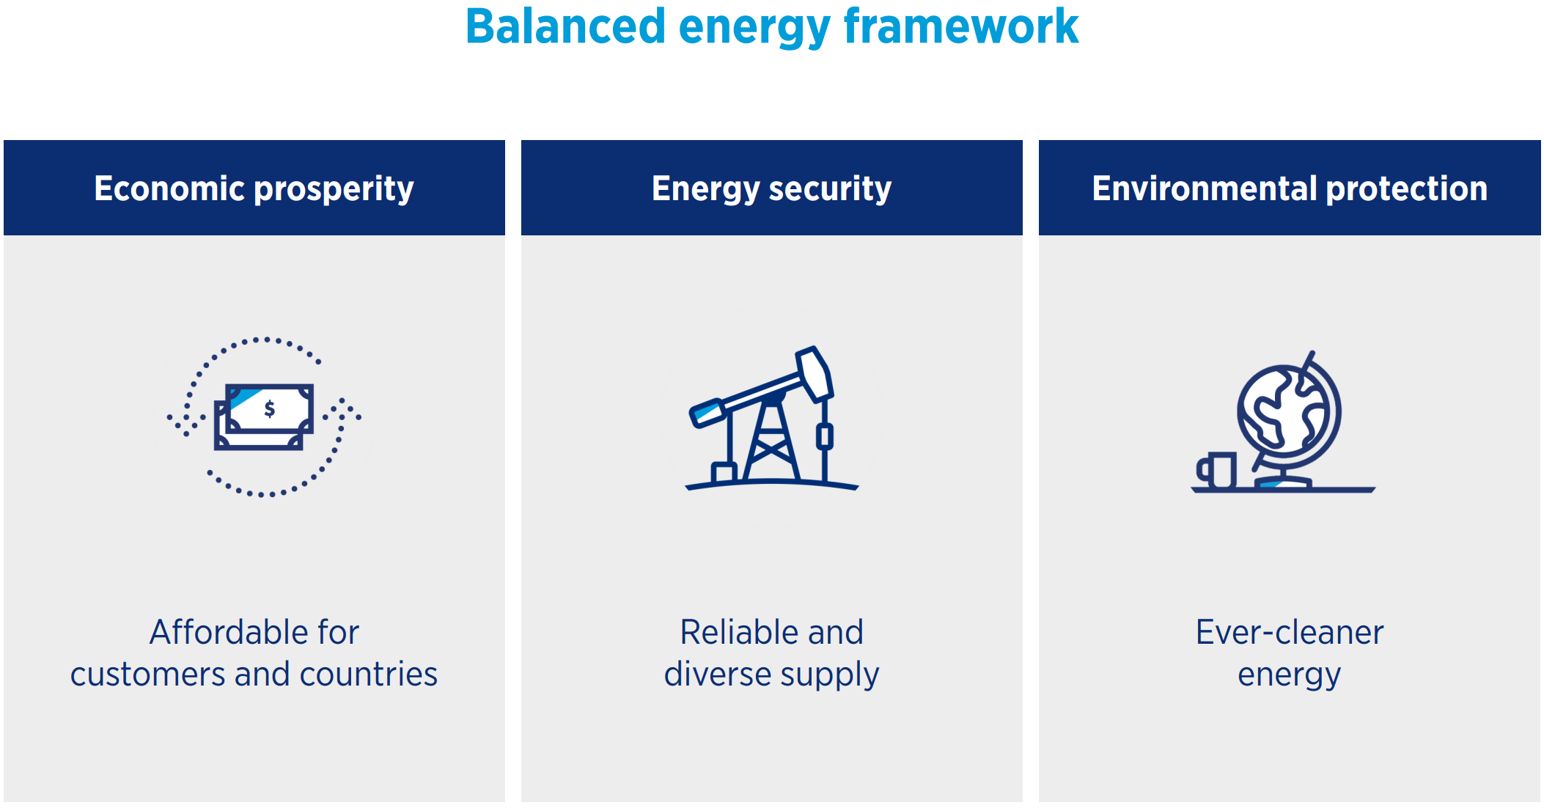
Chevron Overview
Oil and Gas Business
Transportation Fuel
Domestic and Industrial Fuel
Lubricants
Petrochemicals
Energy Transition – Future Business
Carbon Capture Utilization and Sequestration
Hydrogen Fuel
Biofuel
Lithium Production
Electricity Generation
Geothermal Energy

Slide 2

Why we need STEM Education
My Education
High School – Mathematics, Physics, Chemistry
Bachelors Degree – Physics
Masters Degree – Petroleum Engineering
Science, Technology and Engineering Applications
Wells - Mechanical Design and Operations
Reservoirs – Geological and Physics Modeling
Planning – Economic Modeling
Uncertainty Management – Statistics
Chemical Treatments – Chemistry
Monitoring – Remote Sensing and Robotics

